Slide 1
Synergetic Play Therapy
Dara Lynne Tabugadir, LPC, NCC
Instructor/ Therapist- CU School of Medicine, Dept. of Psychiatry
Stress, Trauma, Adversity Research, & Treatment (START) Clinic

Slide 2
Nice to meet you!
Received my BA in Psychology, and minored in Anthropology from MSU Denver
Received my MA in Clinical Mental Health Counseling from UNC
School based work + play= Fun and witnessing transformations

Slide 3
Objectives
Understand the basics of Synergetic Play Therapy (SPT) including the tenants, terminology, and play therapy influences
Describe techniques/interventions to help youth attach to self, and to help with regulation
Gain an understanding of how SPT can help address trauma symptoms

Slide 4
What is Synergetic Play Therapy (SPT)?
Research informed model of play
Nervous system regulation, interpersonal neurobiology, physics, attachment, mindfulness and therapist authenticity
A way of being in relationship with self and other
Roots and Influences
Notes:
From SPT website:
ROOTS:
Child-Centered Play Therapy: • The use of observation and tracking statements, helping the child know that the therapist is with them and following their play • The understanding that the relationship is a key element in the healing process • The understanding that children are wise and innately know what is needed inside to heal
Experiential Play Therapy: • During dramatic play, it is important for the therapist to fully enter the child’s play instead of being an observer of the play
Gestalt Play Therapy: • The understanding that healing occurs in the “here and now” • The importance of authenticity in relationship with the child • An emphasis on both the relationship with the self and with other • An emphasis on the totality of integration of the total organism- the senses, the body, the emotions and the intellect
Influences: Play, Theraplay, EMDR, Attachment theory, and Somatic and Body Centered Therapies

Slide 5
SPT is Research Informed
Merging of Child centered play therapy, Gestalt, experiential play therapy, and neuroscience
Inclusive! (Kool, R Lawyer, 2010)
Limitations (Simmons, J. 2020)
Research in progress (https://synergeticplaytherapy.com/current-research/):
Pediatric Symptom Checklist (PSC)
Compassion Fatigue
Notes:
LOTS of research analyzing effectiveness of CCPT.
Inclusive to all populations: applicable to young children, elementary aged children, adolescents, young adults, adults, and elderly. Telehealth. Targets academic challenges/issues, ADHD, anxiety, withdrawal, emotional lability, learning difficulties, fear, externalizing behaviors, improving self efficacy, aggressive behavior, chronic illness, victims of natural disaster, cultural issues, LGBTQIA+, ASD, sensory processing, child maltreatment, and palliative care, Kool R, Lawver T. Play therapy: considerations and applications for the practitioner. Psychiatry (Edgmont). 2010 Oct;7(10):19-24. PMID: 21103141; PMCID: PMC2989834.
LIMITATIONS: Understanding cultures and ethnic groups and what ‘play’ looks like on overall development, what the ‘role’ of caregivers look like that might influence play process, understanding the emotional culture and degree of emotional expressions in various cultures, and communication of progress from parents
Research in progress: because it is pretty new, → Pediatric Symptom Checklist (PSC)- empirically validated psychosocial screen designed to facilitate the recognition of cognitive, emotional, and behavioral problems.

Slide 6
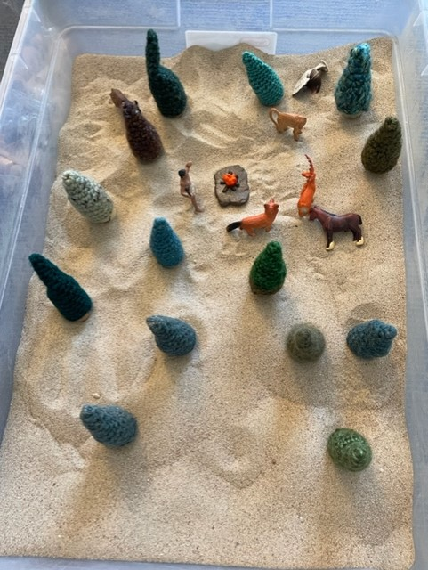

Slide 7
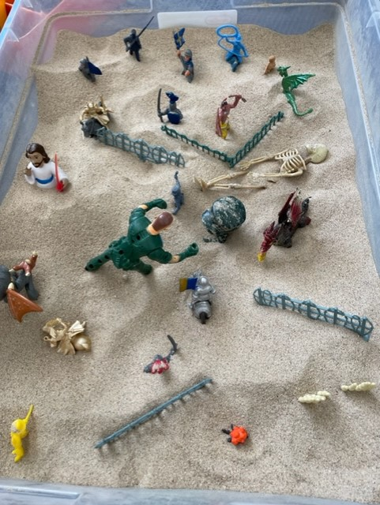
Notes:
SPT allows effective rapport building compared to traditional psychodynamic and CCPT models where it takes more than 1 session for a child to feel seen, heard, and understood. Already repattering the brain and nervous system

Slide 8
Synergetic: systems in transformation
Therapist attunement
+ = Co-regulation
Attunement of child
Goal: helping children stay connected to themselves when dysregulated, learn to feel it without being consumed by it.
Notes:
“Synergetic”: multiple systems working together to create a ‘synergy’ that each individual system cannot be created on its own.
This term reflects the occurrence in play and how integration and healing occurs.
Therapist attunes, Attunes to internal systems of the child and a union of systems occur→ coregulation emerges.
co-regulation supports both the therapist and the child in their ability to move towards the uncomfortable thoughts, feelings, and body sensations that they would not have been able to move towards as easily on their own

Slide 9
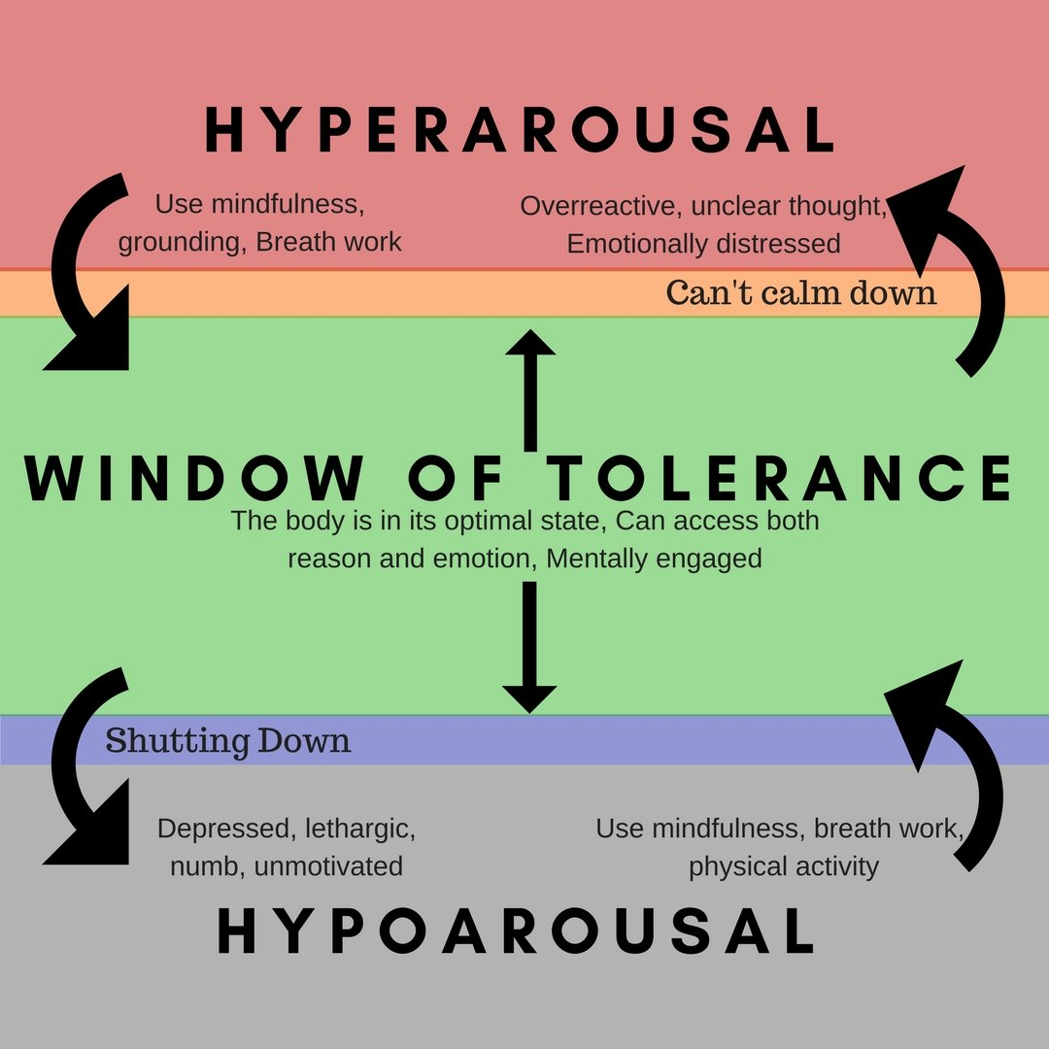
What it Means in SPT
Projective Process: “Disowned Parts”
The “Set Up”/ “The Offering”
Regulation does NOT mean “calm”
-External regulator
Dual Attention
Window of tolerance
Retrieved from: https://www.richardbamfordtherapy.co.uk/blog/window-of-tolerance/
Notes:
Disowned parts: “look outside of me to understand who I am”
- means any part of me that I haven’t learned to love
-project unintegrated painful memories, the parts of experiences we have not been able to integrate into our lives, makes sense, or regulate through.
-SPT helps integrate +/- parts of ourselves and move towards challenging memories, thoughts, and sensations that are perceived as painful so we can integrate in our lives.
Setup/ offering: child projects their inner world onto the toys, and therapist. Setting them up to experience their perception of what it feels like to be them. We feel it in our own nervous system (mirror neurons in neurobiology)→ attunement
Regulation: Means “mindfully connected”
-Activating the ventral parasympathetic system (breathing, movement, rocking, congruent/ authentic response, naming your experience). This is being modeled→ mirror neurons
-addition of SPT—allowing for genuine, authentic expression by the therapist of the impact of the play itself and the role of the therapist as “external regulator” (Dion 2018, p. 52) of the child’s range of emotions—appears to assist the child actively in learning how to self-regulate.
Dual: as therapist is regulated, child borrows the therapist’s regulatory capacity. This is supported in staying their window of tolerance. This supports moving towards intensity and perceived challenges to integrate into life.
When caregivers are in the session, therapist takes the role of a coach, coaching parents on how to help co-regulate their child

Slide 10
Types of Reflections in SPT
Observational Based
Body based
Limbic based
Cortex based
Notes:
Observational: Stating the obvious and lets child know you are with them. “the dinosaur is attacking the dragon”
Body: helps child become mindfully aware what’s happening in their body, when describing what is happening in your body. “My stomach feels tingly and it’s hard to take a deep breath”
Limbic: Helps child feel “felt and understood” and become curious about their own feelings when you describe your own feelings. “I feel scared.” ‘I don’t know what to do when the noise keeps getting louder”
Cortex: Helps child become curious about what is happening in their own minds when you describe what’s happening in your own mental capacity. “My brain feels like it’s running, and it’s hard to focus.”
Relational: Helps child become aware of the relationship itself when you describe what’s happening relationally between you and child. “you’re in that corner, and I’m in the middle of the room.” “we are playing a game together.”

Slide 11
Case
Kyle is a Black, 6 year old boy, who was removed from his biological mother’s care after having been exposed to domestic violence between his mother and mother’s partner, as well as having experienced physical abuse by mother’s partner. Since removal, Kyle now lives with his biological father, his partner, and his 1 year old half sister. Prior to being removed from mother’s care, Kyle has never had contact or a relationship with his father. Kyle was also enrolled into a new school during the transition.
Kyle’s father expressed concerns including being aggressive with his half sister when he plays with her, being aggressive with peers at school, difficulty listening, reacts and cries when he is alone, sensitive to loud noises, gets easily upset, nightmares, and self blame/ over-apologizing.

Slide 12
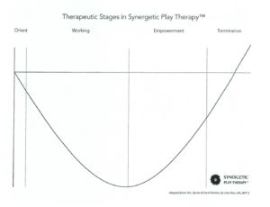
Therapeutic Stages of SPT
Orient: Child orients to you, toys, and the room
Working: Child will do everything in their power to help you understand their experience/ what it’s like to be them
Empowerment: Symptoms integrate as they begin to demonstrate new skills and respond to challenges in new ways
Termination: developmental age matches chronological age, goals are met
Notes:
Play is right brained activity. The curve helps with providing context and language engaging left brain about what is happening in the play

Slide 13
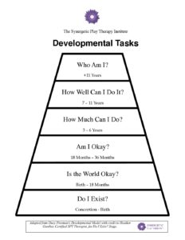
What it looks like in the Playroom
Meaning making, integration. Emotional age matches developmental age
Quality over quantity;
Emphasis is on quantity over quality;
It’s the therapist; rules change on you, confused, being handcuffed, eyes rolled at you, ‘good’ or ‘bad’ person
Emphasis is on environment; hypervigilance, anxiety, explosions, mixed messages, uncertainty. Sense that the world is not okay.
Crawled up, minimal talking, eye contact, & movement, often hypoaroused, collapsed experience
Notes:
Components above the red line= empowerment stage on the curve.
When we feel like we made a mistake, we get triggered and hop below the red line. The bottom three are components of our self concept that are impacted that influences where we are in the window of tolerance. We often have that “something” that had happened between the ages of 3-6. When we get triggered or stressed, we go back to those places coinciding with Am I okay?, Is the world okay? And do I exist? (EMDR influence with touchstone targets)

Slide 14
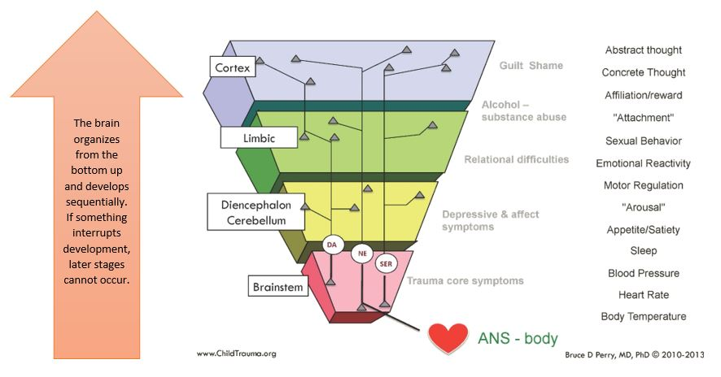
Caregiver involvement and Support
Caregivers identify symptoms
SMART Goals with caregivers determined
SPT helps caregivers be their own external regulators for their child
Psychoeducation
Attunement and Modulation
Whole Brain Child- Good Resource!
Retrieved from: https://johansonconsulting.ca/2020/04/28/growing-resilience-stepping-into-your-power/
Notes:
Due to the convergence of neuroscience, interpersonal neurobiology, attachment→ many avenues of coaching and supporting parents are available
Right brain to right brain

Slide 15
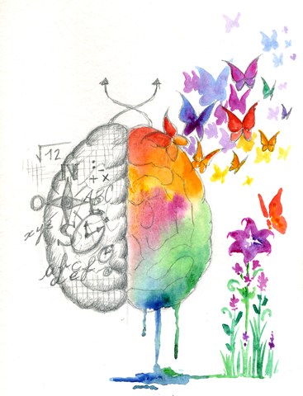
4 Threats to the Brain
Physical and emotional safety
The unknown
Incongruence in the environment
“Should” ourselves
Notes:
Physical/ emotional- am I safe, creating this in the play room with congruence
Unknown- new sensory data, brain figures out what to do with the data, what’s going to happen next. We take things from our past that have not been integrated, put it in the unknown- and make the assumption that we’re about to experience pain that we’ve experienced in the past. Make the unknown, known (timing, transitions, calendars, countdowns)
Incongruence- when things don’t add up or make sense. (angry and have a smile on face). We see this a lot with caregivers and families who aren’t attunement→ puts child on high alert. Brain likes patterns (mirror neurons); in play- we stop and think about how are we congruent and authentic in the playroom
Shoulds- when we should ourselves, we dysregulate ourselves. You expect yourself to be someone different than who you are in the moment. → body moves to fight flight freeze or collapse. You’re battling yourself against the perception of the should because it blocks your own authenticity
Playroom- following intuition to guide us to the next moment. Play is not scripted or have an agenda; modeling trusting self in play to gain information what you need.

Slide 16
9 Tenants of SPT
7) Supports child getting in touch with their authentic self rather than who the child thinks they should be
8) Synergy between the therapist’s authenticity, attunement, congruence and NS regulation support the child in learning how to attach to self= cornerstone of all healing
9) Child project their inner world onto toys and therapist setting them up to experience their perception of what it feels like to be them.
Support the child in changing their perceptions of a perceived challenging event(s) and thoughts in their lives
Attunement is essential to heal disorganization in lower brain and repattern nervous system
Self regulation is modeled by therapist because children learn through observation
4) Child feels safe and engages in reflective awareness through mindfulness, congruency and authenticity from therapist
Symptoms= dysregulated states of nervous system
Therapist is the most important toy in the playroom→ facilitates the relationship
Notes:
These tenants actively help decrease symptoms of trauma. The healing or relief of symptoms is through authenticity, congruence, and attunement to the child’s experience as the child invites us to join their play. The play process assists with repatterning the nervous system (soothing) and creating new neural pathways for adaptive coping and increased regulation,, allows one to practice and manage thoughts and feelings, express and understand big emotions, enhance attachment, and naturally, play is a natural form of language of expression that helps integrate meaning.

Slide 17
Resources/References
All information taken from 6 months SPT training.
Training completed through: Synergetic Play Therapy Institute. Trainer: Lisa Dion, LPC, RPT-S
Website, free resources, trainings, and certification information: www.synergeticplaytherapy.com
Kool R, Lawver T. Play therapy: considerations and applications for the practitioner. Psychiatry (Edgmont). 2010 Oct;7(10):19-24. PMID: 21103141; PMCID: PMC2989834.
Simmons, J. (2020). Moving toward regulation using synergetic play therapy. West Vancouver, British Colombia: Canadian Journal of Counseling and Psychotherapy. Retrieved from https://cjc-rcc.ucalgary.ca/article/view/69443/54280

